Slide 1
T-FLIP Backend Layer and Current State

Slide 2
Student perspective
Easy to use
Fun to use
Notifications
Teacher/Dev perspective
Easy to maintain
Deployment
New Developers

Slide 3
Different implementations
Some courses may prefer to use Atlassian tools only (Intermediate+)
Beginner courses may need an easy to use front-end
Independant of Atlassian tools? (Bamboo + Stash)

Slide 4
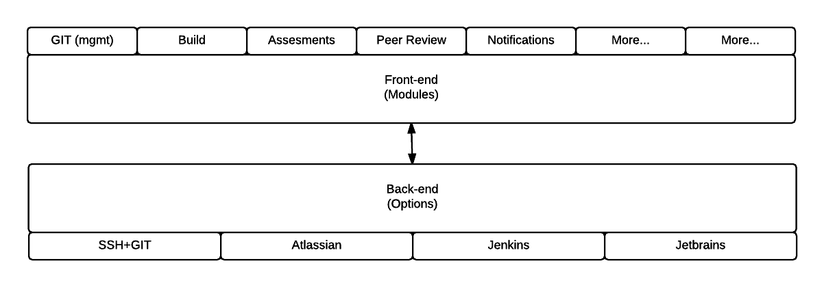
Beginner: Example

Slide 5
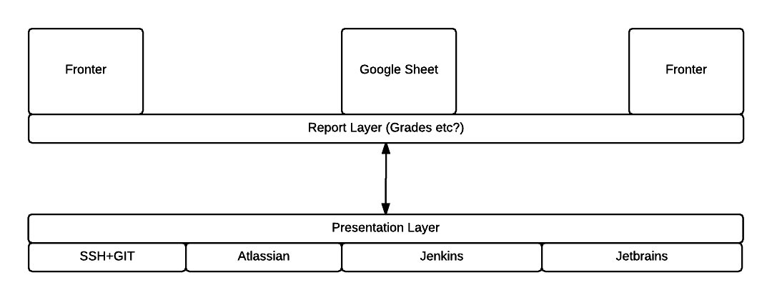
Intermediate: Example

Slide 6
Current Implementation: Good and Bad
Current Solution:
Unit tests runs in Bamboo. Scripts are in charge of cleaning, and implementing test tools to the students assignment. A HTML report is generated and presented as a build artifact in bamboo
Testing environment runs on virtual machines (Vagrant)
The Good:
Primitive
Easy to maintain
Learn students to use relevant tools
Build environment is very good (Vagrant setup)
The Bad:
Does not scale very good
False positives.
Cheating possibilites.
Huge learning curve for new students
No x/y report in Bamboo
No acceptable peer review solutions integrated in bamboo
Bamboo as dependency

